Slide 1
CPU Design
Last Time
Major Ideas and Concepts
CISC and RISC Architectures
Major RISC Differences
RISC vs. CISC Performance
Addressing
Modern CPU Methods

Slide 2
Last Time
Hierarchy of storage, ranging from CPU registers to magnetic tape
Layout, operation and performance considerations of magnetic disks, including hard disks, floppies, alternative technologies and disk arrays
Organization of magnetic tape
Layout and operation of CD-ROMs and other optical and magneto-optical disks,and comparison with magnetic disks
Methods used to produce images on a display and the requirements on the system
Operation of various printer technologies in common use

Slide 3
Major Ideas and Concepts
Differences between CISC and RISC architectures and the arguments and justifications for each
Different ways that instructions can address memory
Major concepts pipelining and superscalar processing
Different ways in which the CPU can be implemented

Slide 4
CISC and RISC Architectures
Two primary architectures used in design of today’s modern computer
  Complex instruction set computer (CISC)
  Reduced instruction set computer (RISC)
Represent very different approaches in CPU design
Given the differences - both CISC and RISC are consistent with Von Neumann’s computer design

Slide 5
CISC and RISC Architectures
CISC is the traditional architecture
Most often thought of when we think CPU
Complex instruction set
  Hundreds of instructions
  Multiple instruction formats
Roots go back nearly 40 years
Instruction set grew as direct result of compiler development
Attempt to simplify generated compiler code

Slide 6
CISC and RISC Architectures
RISC relatively new concept - if you call 25+ years new
1974, John Cocke, IBM Research goals:
  Dramatically reduce the number of instructions
  Higher performance, easier and less expensive to manufacture
  Produce more CPU power
  Execute more instructions in same timeframe than CISC-based CPU
CISC circuitry additional complexity designed to support rarely executed instructions
RISC-based CPUs have inherent advantage
  Fewer instructions
  Less circuitry means less overhead
What about the original compiler-needs premise?

Slide 7
CISC and RISC Architectures
Results from studies conducted in late1970s, early1980s establish instruction usage patterns for assemblers and compilers indicate:
  10 instructions accounted for 71% of all instructions executed an IBM System/370
  Programmers and compilers avoided the use of complex instructions
  Procedure and function calls became a bottleneck
  Because of the number of registers they require
  Saving, using and reloading of registers slowed instruction execution down
  Not enough registers available to avoid the savings and reloading processes

Slide 8
Major RISC Differences
Limited instruction set – RISC has considerably fewer instructions
Shorter Instructions – Instructions have simpler format allowing them to be shorter
Register oriented instructions – RISC instruction set uses faster register-oriented instructions
Limits Memory Access – limiting the number of slower memory access instructions

Slide 9
Major RISC Differences
Fixed length, fixed format instructions
  RISC instructions are all the same format
  Instructions are the same size
  Instructions can be fetched in one machine cycle
  No waiting until the length of the previous instruction is known in order to fetch and decode the next instruction
Limited addressing modes – RISC provides only single addressing mode for addressing memory verses multiple addressing modes in CISC
Lots of registers – RISC provides many more registers than CISC
Enables RISC to avoid the costly time-consuming process of saving the contents of registers

Slide 10
RISC vs. CISC Performance
Considerable debate over which architecture offers higher performance and better value
One argument in favor of CISC
  Due to the simplicity of the instruction set
  Suggests simpler RISC instruction set results in larger memory requirements
  Essentially requiring more instructions i.e. creating larger programs to do the equivalent task
  Therefore, requiring more memory
  Increase in instructions creates more memory accesses to fetch the instructions

Slide 11
RISC vs. CISC Performance
Some critics of RISC believe the large number of registers is the key to RISC performance
CISC had an equivalent number of registers would show increased performance
Debate continues with some merit on both sides
What do you think will happen?
What is ultimately happening is convergence
CISC and RISC implementations becoming more alike
Many of today's RISC chips support as many instructions as yesterday's CISC chips
Today's CISC chips use many techniques formerly associated with RISC chips

Slide 12
Addressing
Two different addressing techniques: absolute and relative
Absolute - early addressing scheme
Had to know exactly where the program was loaded into memory
Programs were written in a way that told the computer where to place our program in memory
Which worked part of the time, didn’t know what else was running in the computer or stored in memory
Failed attempts at executing our programs due to the collisions with other programs
Needed to know where the operating system was loaded so that we didn’t interfere with it
Absolute addressing was not a very effective addressing scheme for running multiple programs

Slide 13
Addressing
Relative addressing - a really cool concept
Made programs memory address independent
Registers to load program’s starting memory address (our program’s first instruction) into a register
Subsequent instructions would be addressed relative to the starting address
Didn’t need to know where in memory the program was loaded
Or what other programs were loaded in memory
Language compilers continue to use this technique today

Slide 14
Modern CPU Methods
Accomplishes a unit work by executing instructions
Work is measured by the number of instructions the computer can execute in a given unit of time
Number of ways the number of instructions executed per unit of time can be increased
Multiprocessing - Simply increase the number of CPUs
Unfortunately this method is costly
Increase CPU performance – using parallel activities
One scalar technique is called pipelining

Slide 15
Modern CPU Methods
Pipelining is the use of an assembly line
Without a pipeline, processor gets the first instruction from memory, performs the operation and then gets next instruction
Pipeline provides:
  Continuous and overlapped movement of instructions to the processor
  Or arithmetic steps taken by the processor to perform an instruction
While fetching the instruction, the arithmetic part of the processor is idle - It must wait until it gets the next instruction
Architecture allows next instructions to be fetched while the processor is performing arithmetic operations
Holding them in a buffer close to the processor until each instruction operation can be performed
Staging of instruction fetching is continuous
Resulting in an increase in number of instructions performed

Slide 16
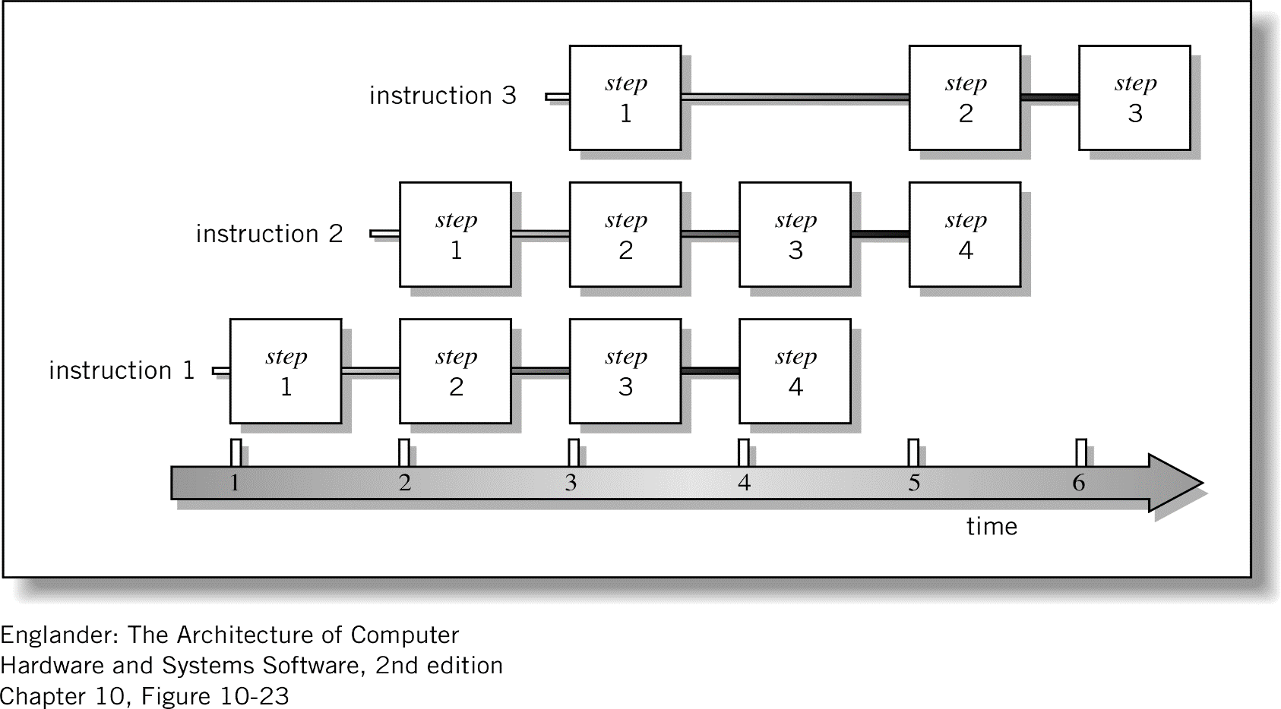
Modern CPU Methods

Slide 17
Modern CPU Methods
If one pipeline is good could more pipelines be better?
Use of multiple pipelines is known as superscalar
Superscalar design is sometimes called second generation RISC
Superscalar describes CPU design that makes it possible to execute more than one instruction during a single clock cycle
CPU is divided into 2 parts
  Fetch - Instruction Fetch/Decode Unit
  Execute – Execution Unit
Superscalar design, processor or the instruction compiler determines which instructions can be carried out independently
Whether a dependency on another instruction must be executed in sequence with it
Processor uses multiple execution units to simultaneously carry out two or more independent instructions

Slide 18
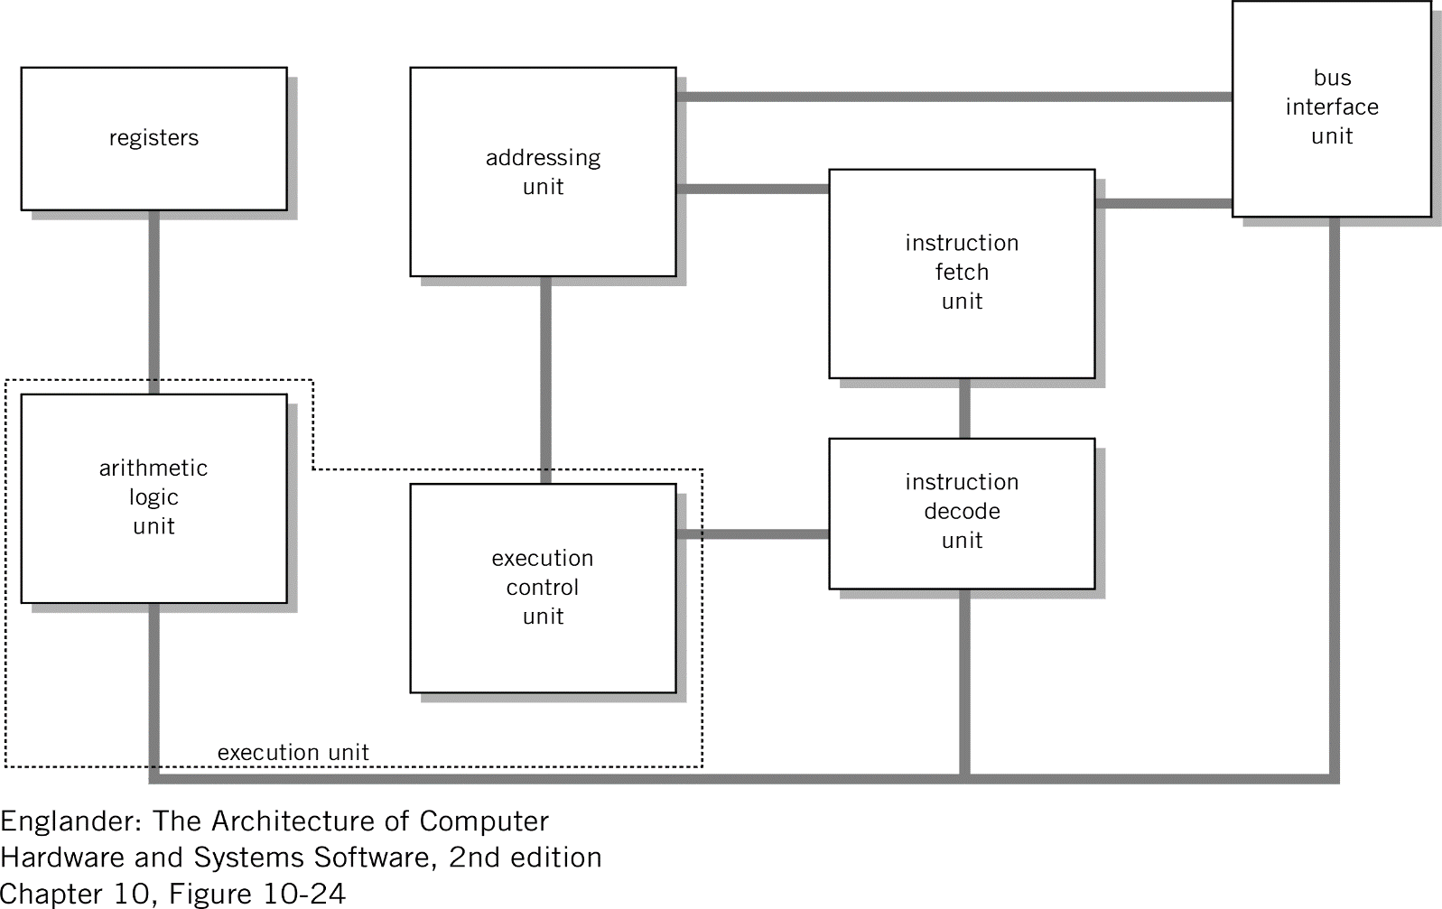
Modern CPU Methods

Slide 19
Modern CPU Methods
Superscalar processing sounds great
Complicates the CPU design considerably
Number of sticky issues that affect its performance:
  Out of order processing – executing later instructions before the results of previous instructions are known
  Change in program flow - conditional branch instructions cause this to happen
  Pipeline could be filled with instructions that will be branched around
  Resource conflicts – instructions often use the same physical registers as assigned by the programmer or the compiler
Pipelining and superscalar do not effect the cycle time of any individual instruction

Slide 20
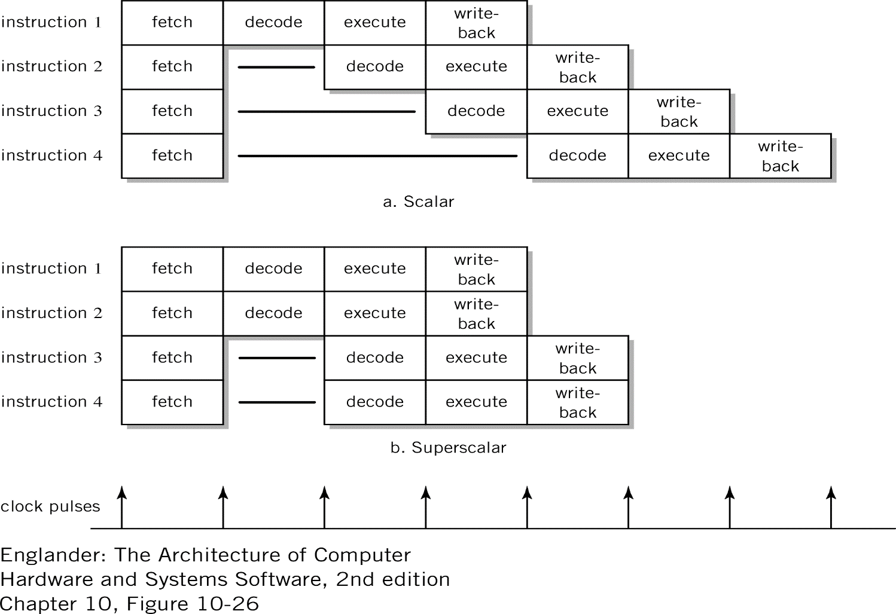
Modern CPU Methods

Slide 21
Next Time
Input and Output

